Slide 1
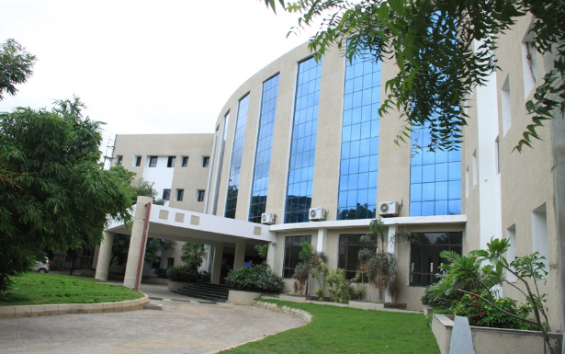
ATTENDANCE MANAGEMENT SYSTEM BASED ON FACE RECOGNITION
Presented by
1. K. MANOHAR REDDY : 19QM1A0431
2. N.V.V.RAMANA REDDY : 19QM1A0446
3. P. SAI KARTHIKA : 19QM1A0455
4. R. DEEPAK REDDY : 19QM1A0456
Under the Guidance of
Mr. Vijaya Bhasker Reddy M. Tech (Ph. D)
Assistant Professor

Slide 2
CONTENTS
Introduction
Literature Study
Problem Statement
Problem Scoping
Aim/Objective
Methodology
7.Tools required
8.Working principle
9.Results and discussion
10.Conclusion
11.Future work
12.Reference

Slide 3
Introduction
Attendance is an important part of daily classroom evaluation. At the beginning and ending of class, it is usually checked by the teacher, but it may appear that a teacher may miss someone or some students answer multiple times. Face recognition-based attendance system is a problem of recognizing face for taking attendance by using face recognition technology based on high definition monitor images and other information technology.
We propose a modular solution to the problem of student attendance by face detection and recognition and identifying multiple faces in real-time to see and mark the attendance of each student.

Slide 4
Literature Study
S.NO | TITLE OF THE PAPER | AUTHORS | CONFERENCE/ JOURNAL NAME | YEAR | PROBLEM ADDRESS
1. | Mobile Based Attendance System: Face Recognition and Location Detection using Machine Learning | M. S. Mubarak Alburaiki, G. Md Johar, R. A. Abbas Helmi and M. Hazim Alkawaz, | IEEE | 2021 | This project proposes a mobile application to allow lecturers to generate class attendance and students to submit the attendance by scanning their faces using their mobile phone camera along with their location.
2. | JomRFID Attendance Management System | Q. Y. Tan, P. S. Joseph Ng and K. Y. Phan | IEEE | 2021 | Using this system, students require to scan their students' cards on the RFID reader, subsequently, the attendance will be recorded into the system automatically.
3. | Classroom Attendance Monitoring Using CCTV | M. R, M. D and R. P | IEEE | 2020 | To avoid manual paper based attendance system nowadays smart attendance monitoring system like biometric facial recognition system is being suggested.
4. | Neural Network based Biometric Attendance System | R. P. Vandana, P. S. Venugopala and B. Ashwini | IEEE | 2021 | This dynamic attendance management system will consider the physiological features of the human beings for uniquely identifying them.

Slide 5
Literature Study
S.NO | TITLE OF THE PAPER | AUTHORS | CONFERENCE/ JOURNAL NAME | YEAR | PROBLEM ADDRESS
5. | Attendance Management System using Facial Recognition | P. Sarath Krishnan and A. Manikuttan | IEEE | 2022 | An automated logging and attendance management system is being proposed with the help of face detection and recognition methods.
6. | SAMS: An IoT Solution for Attendance Management in Universities | G. Sittampalam and N. Ratnarajah | IEEE | 2019 | This paper by using most of the advanced technologies of the IoT (Internet of Things), such as mobility, wireless network, fingerprint sensor and cloud computing.
7. | Automatic Attendance Marker Using Beacon technology | A. Hake, A. Samanta, P. Kasambe and R. Sutar | IEEE | 2022 | An application that automatically detects the presence of the students through their own smartphone with a unique ID.
8. | Face Recognition Method for Online Exams | A. A. Sukmandhani and I. Sutedja | IEEE | 2019 | Biometric systems are usually used to identify and analyze the characteristics of the human body such as fingerprints, retina, sound patterns, facial patterns and other body structures that can be used for system authentication.

Slide 6
Problem Statement
In smart cities, intelligent learning environment is an important application scenario, and class attendance checking is an important measure to urge students to attend on time and ensure the quality of learning. Attendance of the student is very important for every college, universities and school. Conventional methodology for taking attendance is by calling the name or roll number of the student and the attendance is recorded. Time consumption for this purpose is an important point of concern.

Slide 7







Problem scoping
User’s
Schools
Universities
End user
Students
Teachers and management
Existing solution
Calling out the roll call, taking student sign on paper and biometric authentication
MOBILE AIR POLLUTION MONITORING
AND BUS TRACKING
Stake holders
All Educational Institutions
Our solution
Uses real-time face recognition to mark present or absent
Importance to solve
laborious class management
Time Management

Slide 8
Why and Who needs this
Attendance is prime important for both the teacher and a student of an educational organization. So it is very important to keep record of it. The problem arises when we think about the traditional process of taking attendance in class room. Calling name or roll number of the student for attendance is not only a problem of time consumption but also it needs energy. So an automatic attendance system can solve all above problems.
According to many research papers and of our proposed system, the stake holders of this application are Schools, Colleges, Universities and all Educational Institutions etc.

Slide 9
Aim/Objective
Aim: The is to build an “Face-Recognition" based attendance management system which will mark present or absent based on real-time data.
Objective: To store and view registered student data at any given time by their or faculty’s login credentials.

Slide 10
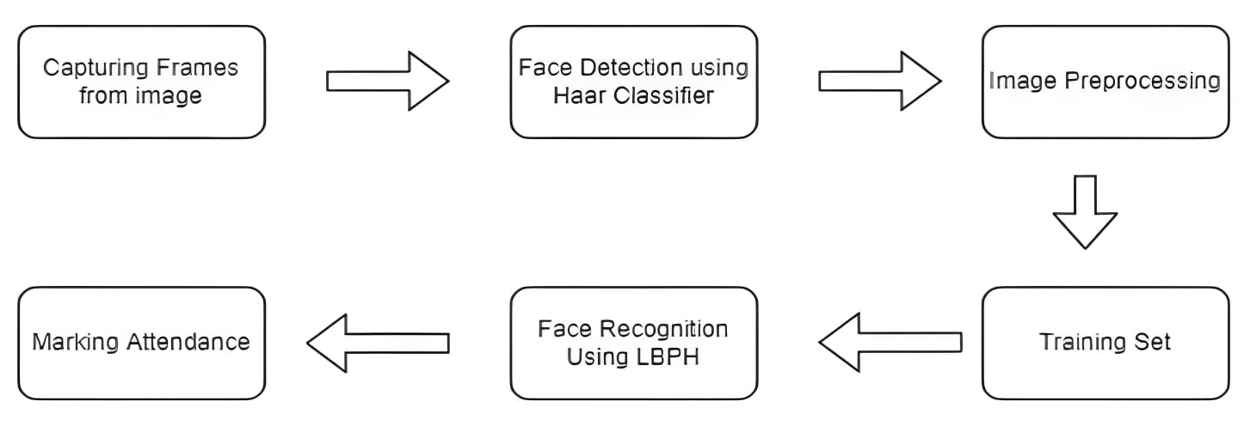
Methodology

Slide 11
References
[1] M. S. Mubarak Alburaiki, G. Md Johar, R. A. Abbas Helmi and M. Hazim Alkawaz, "Mobile Based Attendance System: Face Recognition and Location Detection using Machine Learning," 2021 IEEE 12th Control and System Graduate Research Colloquium (ICSGRC), 2021, pp. 177-182, doi: 10.1109/ICSGRC53186.2021.9515221.
[2] Q. Y. Tan, P. S. Joseph Ng and K. Y. Phan, "JomRFID Attendance Management System," 2021 Innovations in Power and Advanced Computing Technologies (i-PACT), 2021, pp. 1-6, doi: 10.1109/i-PACT52855.2021.9696816.
[3] M. R, M. D and R. P, "Classroom Attendance Monitoring Using CCTV," 2020 International Conference on System, Computation, Automation and Networking (ICSCAN), 2020, pp. 1-4, doi: 10.1109/ICSCAN49426.2020.9262436.
[4] R. P. Vandana, P. S. Venugopala and B. Ashwini, "Neural Network based Biometric Attendance System," 2021 IEEE International Conference on Distributed Computing, VLSI, Electrical Circuits and Robotics (DISCOVER), 2021, pp. 84-87, doi: 10.1109/DISCOVER52564.2021.9663661.
[5] P. Sarath Krishnan and A. Manikuttan, "Attendance Management System Using Facial Recognition," 2022 International Conference on Computing, Communication, Security and Intelligent Systems (IC3SIS), 2022, pp. 1-6, doi: 10.1109/IC3SIS54991.2022.9885693.
[6] G. Sittampalam and N. Ratnarajah, "SAMS: An IoT Solution for Attendance Management in Universities," TENCON 2019 - 2019 IEEE Region 10 Conference (TENCON), 2019, pp. 251-256, doi: 10.1109/TENCON.2019.8929616.

Slide 12
References
[7] A. Hake, A. Samanta, P. Kasambe and R. Sutar, "Automatic Attendance Marker Using Beacon technology," 2022 IEEE Region 10 Symposium (TENSYMP), 2022, pp. 1-5, doi: 10.1109/TENSYMP54529.2022.9864555.
[8] A. Sukmandhani and I. Sutedja, "Face Recognition Method for Online Exams," 2019 International Conference on Information Management and Technology (ICIMTech), 2019, pp. 175-179, doi: 10.1109/ICIMTech.2019.8843831.

Slide 13

Thank You

